Slide 1
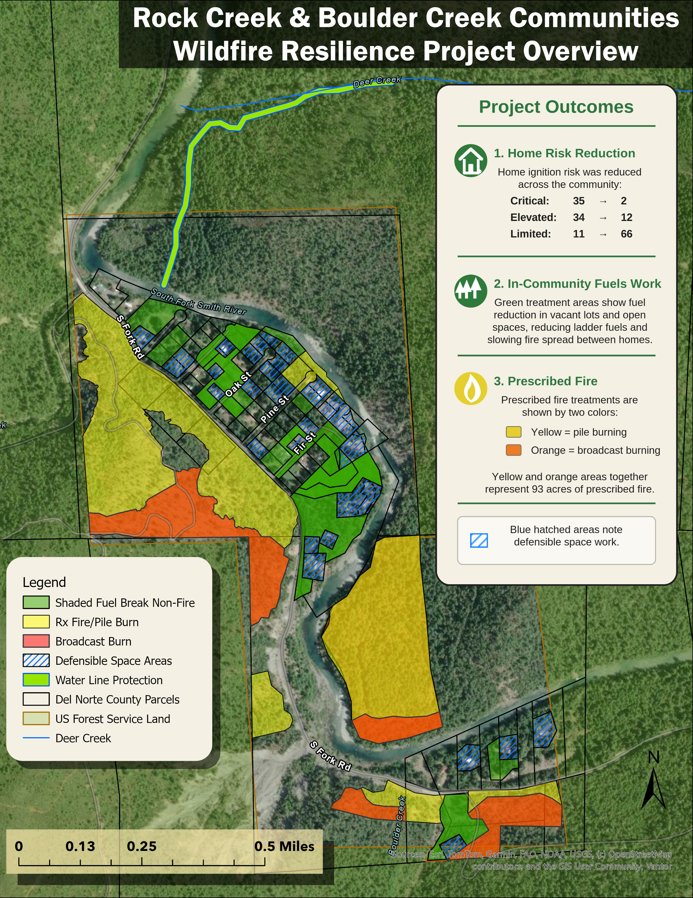
Rock Creek & Boulder Creek
Partner report with Grant Werschkull • Smith River Alliance
Key takeaways
Private Parcel Ignition Risk Reduction
Reduce Critical
35 → 2
Reduce Elevated
34 → 12
Increase Low
11 → 66
Fuel Reduction
Defensible Space (17.4 acres)
33 homes
Community Fuel Breaks
24.0 acres
Prescribed Fire / Pile Burn
92.9 acres
• In-community fuels work and open-space treatments
• Water line protection integrated into the project footprint
• Strong collaboration among SRA, NRCS, Lomakatsi, USFS, CALFIRE, and DNFSC
Del Norte Fire Safe Council • Pre-Season Wildland Fire Meeting • May 2026

Slide 2
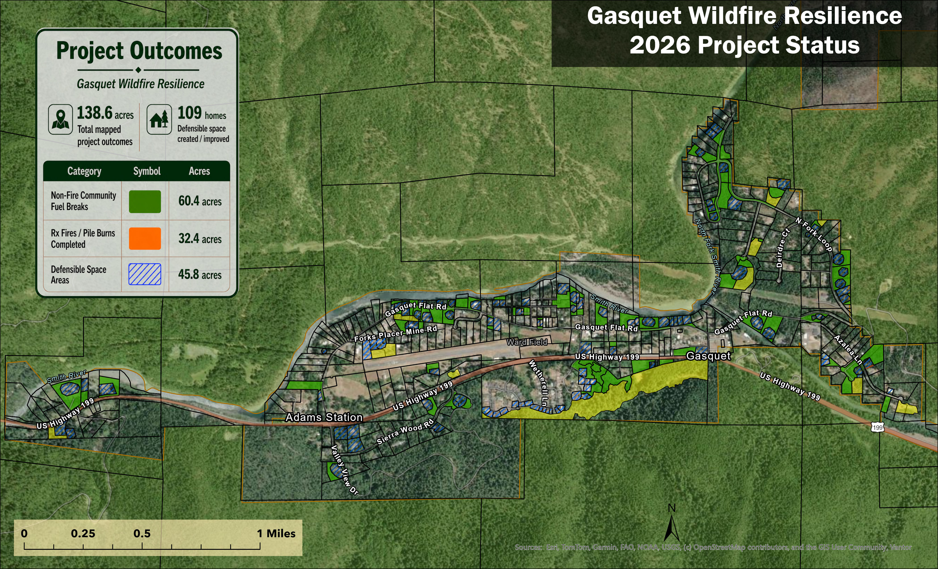
Gasquet Wildfire Resilience
Current work underway along the Hwy 199 corridor under a Community Wildfire Defense Grant
Key takeaways
109 Homes
with defensible space created or improved
Fuel Reduction within Gasquet
Defensible Space
45.8 acres
Community Fuel Breaks
60.4 acres
Prescribed Fire / Pile Burn
32.4 acres
• Defensible space, non-fire fuel reduction, and pile burn / prescribed fire work distributed through Gasquet and surrounding private lands.
• Community-scale protection along a critical Hwy 199 corridor community
• Current implementation connects directly to broader cross-boundary priorities
Del Norte Fire Safe Council • Pre-Season Wildland Fire Meeting • May 2026

Slide 3
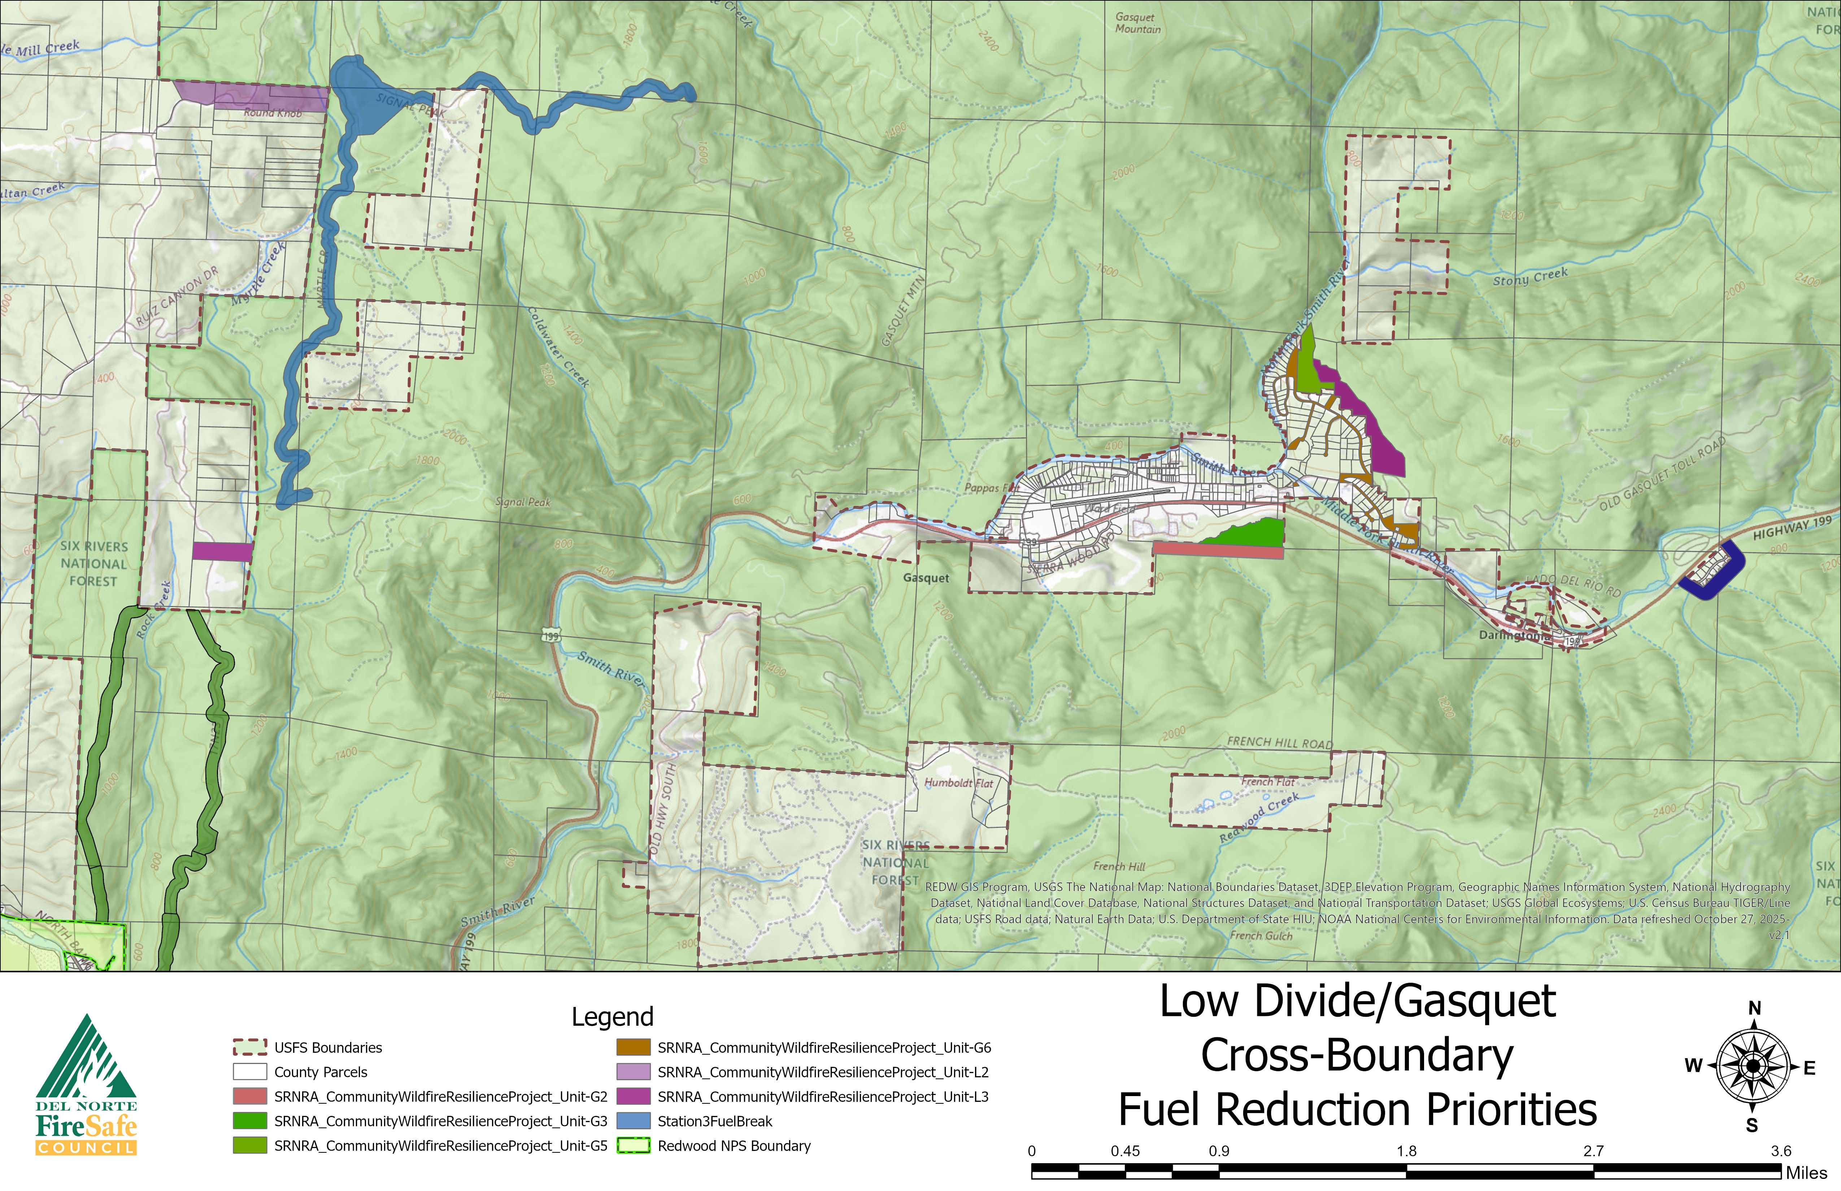
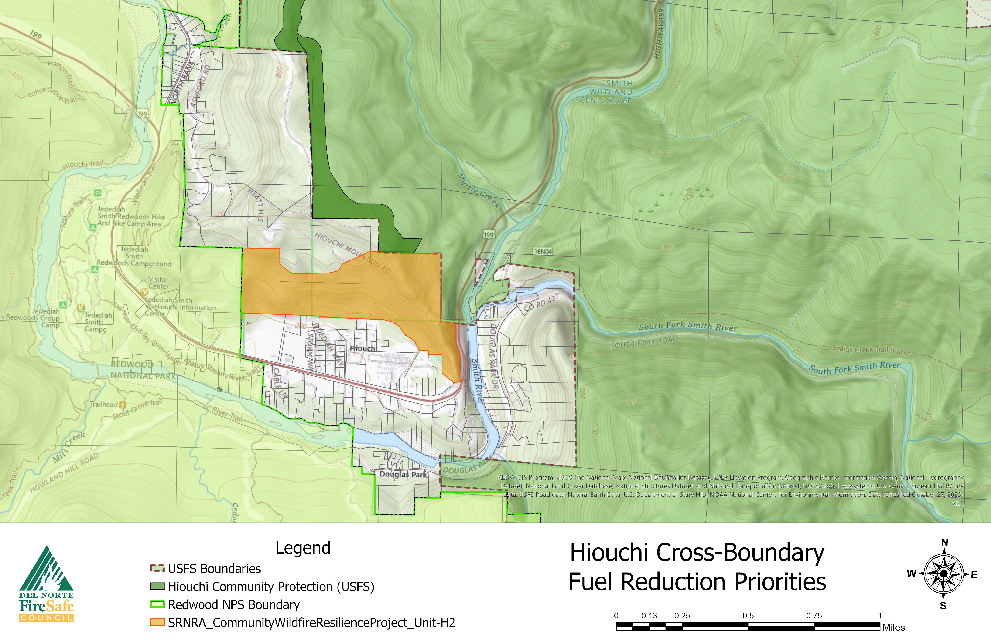
2026 Priorities & What’s Next
Where we are pushing implementation next
Near-term Gasquet/Low Divide Community Wildfire Resilience Project Plans
Hiouchi Community Fuel Reduction Priorities
1
Six Rivers Community Wildfire Resilience
3
South Canyon Understory Burns
Advance major community fuel reduction within and surrounding Hiouchi, Low Divide, and Gasquet.
Introducing prescribed fire on about 140 acres of private land treated previously with NRCS funds.
2
Hiouchi-Smith River Forest Resilience
Trail Restoration
Northern Smith to Klamath Fuel Breaks in partnership with Del Norte RCD, Green Diamond, Del Norte County, USFS, and CALFIRE.
4
Restore approximately 25 miles of community trail systems utilized by firefighters, residents, and visitors before fall 2026.
These next steps continue building treatment continuity from community protection work into larger cross-boundary implementation.
Del Norte Fire Safe Council • Pre-Season Wildland Fire Meeting • May 2026

Slide 4
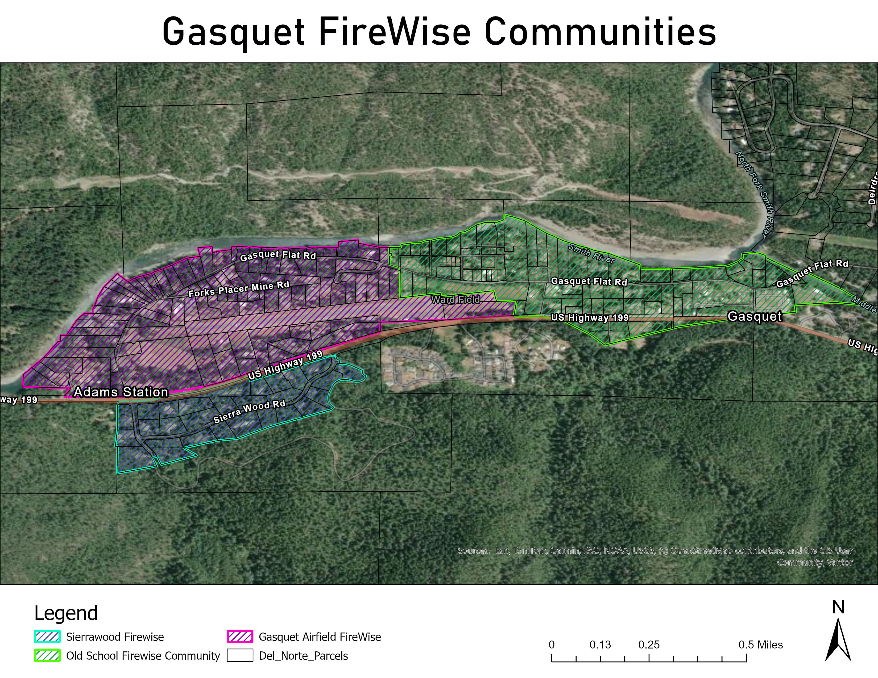
Community Readiness & Stewardship
Programs that build local ownership of wildfire resilience
DSI Program
Firewise Coordinator
Prescribed Burn
Association
• Free home assessments and defensible space inspections
• Actionable recommendations for residents and property owners
• Creates a pathway into on-the-ground mitigation work
• Supports Firewise communities, action plans, and outreach
• Helps organize residents around shared neighborhood risk
• Builds local capacity for long-term community engagement
• Builds community participation in fire management
• Creates opportunities for burn-to-learn events and training
• Helps grow local prescribed fire culture and stewardship
Creating Firewise Communities
• How neighborhood organization can support wildfire preparedness.
• These programs connect household-level action, community leadership, and broader fire stewardship.
Goal: increase public participation and ownership in fire management.
Del Norte Fire Safe Council • Pre-Season Wildland Fire Meeting • May 2026

Slide 5
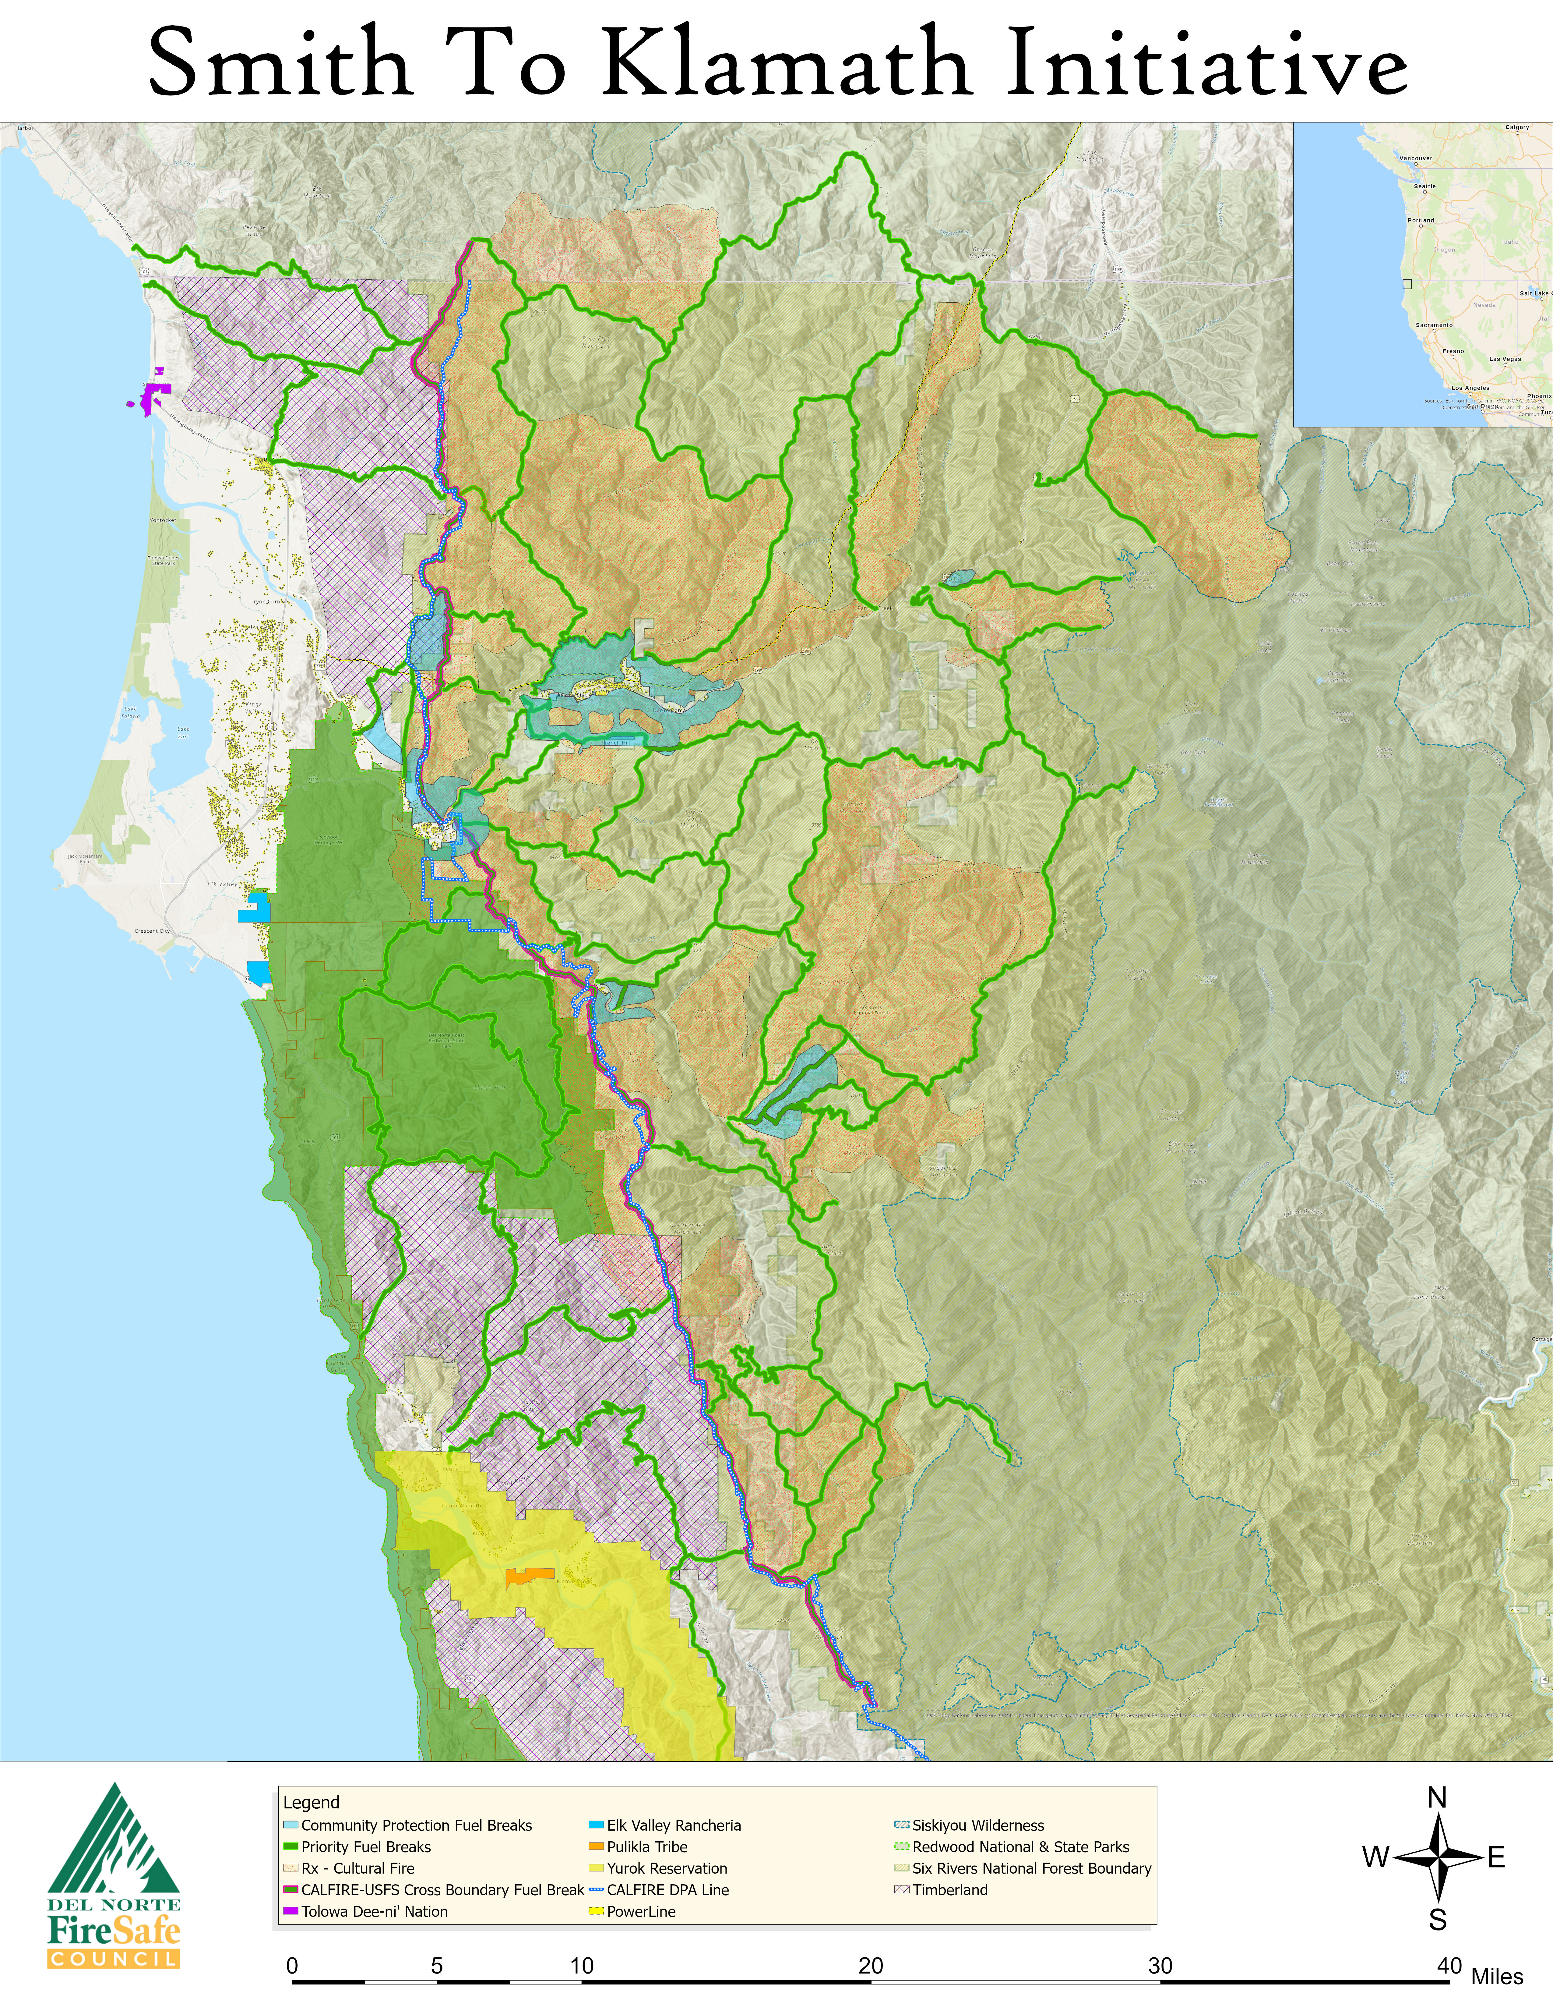
Smith to Klamath Initiative
Landscape-scale wildfire resilience strategy
A Countywide Resilience Strategy
Crossing jurisdictional boundaries to achieve true landscape-scale wildfire resilience across Del Norte County.
6,000 ac
Cross-Boundary Fuel Break
north-south strategic alignment
20,000 ac
Shaded Fuel Breaks
strategically placed across the landscape
11,500 ac
Community Protection Zones
community-focused risk reduction
10,000 ac
Forest Health Thinning
plantation / stand improvement
150,000+ ac
Prescribed & Cultural Fire
over time, as fuel reduction implementation occurs
This Initiative is utilizing currently implemented and planned projects and connecting gaps to create a unified landscape scale wildfire resilience strategy.
Del Norte Fire Safe Council • Pre-Season Wildland Fire Meeting • May 2026

Slide 6
Thank You to Our Lunch Supporters
Lunch made possible by generous community contributors and partners
Thank you
With appreciation to:
• Hiouchi Cafe
• Los Bagels
• Rumiano Cheese
• Gasquet Neighbors Helping Neighbors
• Smith River Alliance
• Smith River NRA / USFS
Del Norte Fire Safe Council • Pre-Season Wildland Fire Meeting • May 2026

